Slide 1
Laravel Validation
Course Code: CSC 4182
Course Title: Advanced Programming In Web Technologies
Dept. of Computer Science
Faculty of Science and Technology
Lecture No: | 17 | Week No: | 11 | Semester: | Summer 2020-2021
Lecturer: | MD.AL-AMIN; alamin@aiub.edu

Slide 2
Lecture Outline
Using Validator
Rules Of Validation
Keeping Old Form Data
Printing Error Message
Customize Error Message
Separating Validation: Request Class

Slide 3
Using Validator
Laravel ships with a simple, convenient facility for validating data and retrieving validation error messages via the Validator class.
$validator = Validator::make(
['name' => 'Dayle'],
['name' => 'required|min:5']
);
The first argument passed to the make method is the data under validation. The second argument is the validation rules that should be applied to the data.
$validator = Validator::make(
[
'name' => 'Dayle',
'password' => 'lamepassword',
'email' => 'email@example.com'
],
[
'name' => 'required',
'password' => 'required|min:8',
'email' => 'required|email|unique:users'
]
);

Slide 4
Using Validator
Once a Validator instance has been created, the fails (or passes) method may be used to perform the validation.
if ($validator->fails())
{
// The given data did not pass validation
}
If validation has failed, you may retrieve the error messages from the validator.
$messages = $validator->messages();
You can also use the following equivalent code. In this case the associative indices of validation rules must be same as name fields of forms.
$validator = Validator::make($request->all(), [
'title' => 'required|unique|max:255',
'body' => 'required',
]);
Don’t forget to use Illuminate\Support\Facades\Validator class.
use Illuminate\Support\Facades\Validator;

Slide 5
Rules Of Validation[Mostly Used]
Topic sub heading..
required - The field under validation must be present in the input data.
Example: 'email' => 'required|email',
size:value - The field under validation must have a size matching the given value. For string data, value corresponds to the number of characters. For numeric data, value corresponds to a given integer value. For files, size corresponds to the file size in kilobytes.
Example: 'id' => 'required|size:10',
string - The field under validation must be a string type.
Example: 'fname' => 'required|string|max:100',
date - The field under validation must be a valid date according to the strtotime PHP function.
Example: 'reg_date' => 'required|date',
email - The field under validation must be formatted as an e-mail address.
Example: 'email' => 'required|string|email',

Slide 6
Rules Of Validation[Mostly Used]
digits:value - The field under validation must be numeric and must have an exact length of value.
Example: 'marks' => 'required|digits:3',
integer - The field under validation must have an integer value.
Example: 'price' => 'required|integer',
max:value -The field under validation must be less than or equal to a maximum value. Strings, numerics, and files are evaluated in the same fashion as the size rule.
Example: 'marks' => 'required|integer|max:100',
min:value - The field under validation must have a minimum value. Strings, numerics, and files are evaluated in the same fashion as the size rule
Example: 'marks' => 'required|integer|min:0|max:100',
numeric - The field under validation must have a numeric value.
Example: 'marks' => 'numeric|max:100',
regex:pattern - The field under validation must match the given regular expression.
Example: 'phone' => 'required|regex:/^([0-9\s\-\+\(\)]*)$/',
mimes - The file under validation must have a MIME type corresponding to one of the listed extensions.
Example: 'photo' => 'mimes:jpeg,bmp,png'

Slide 7
Rules Of Validation[with Database values]
With Laravel validator we can also validate a value with database
exists:table,column - The field under validation must exist on a given database table.
Example: 'state' => 'exists:states',
unique:table,column,except,idColumn - The field under validation must be unique on a given database table. If the column option is not specified, the field name will be used.
Example: 'email' => 'required|email|unique:users',
Specifying A Custom Column Name: 'email' => 'unique:users,email_address'
For More: https://laravel.com/docs/5.0/validation#available-validation-rules

Slide 8
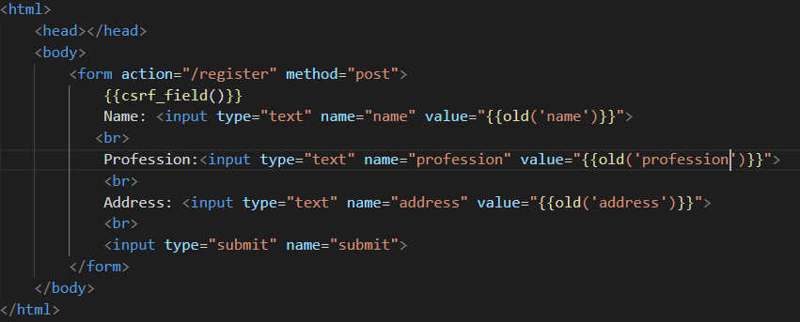
Keeping Old Form Data
Submitted data can be retrieved by old() method in Laravel.

Slide 9
Printing Error Message
Errors are stored in $errors object. $error object has a method called first() which receives the element name as a parameter.
$errors->first('name') will print the first error occurred in name field
$errors->has('name') method will check if there is any error in name field
If there is any error() has method will return true other wise false.
If there are multiple error occurred in field first() method will return the first error.

Slide 10
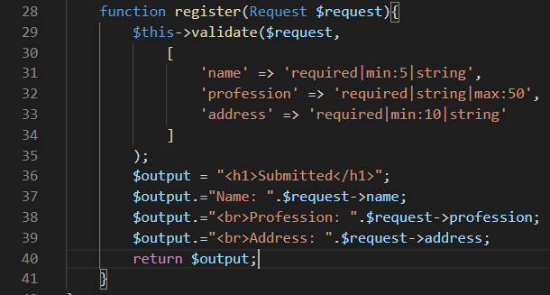
Complete Example [Validation Function]

Slide 11
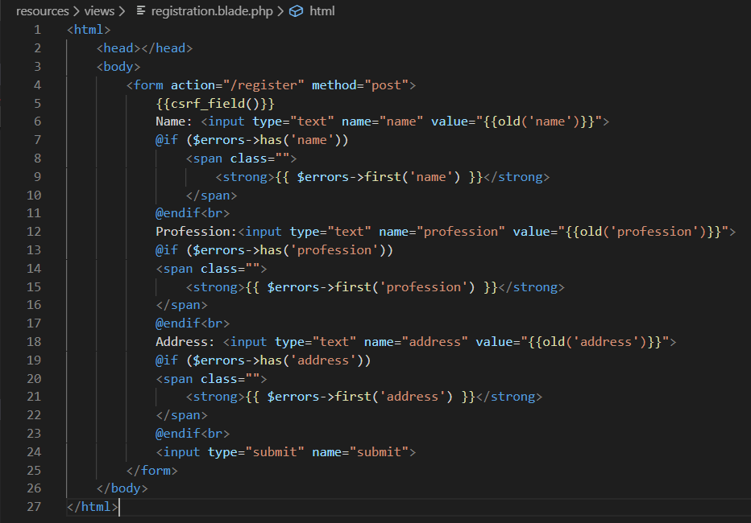
Complete Example [HTML Code]

Slide 12
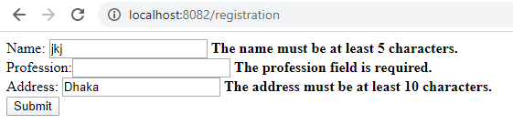
Complete Example [output]
These names are from html name fields’ value. Other portions of the error messages are generated from the rule we gave.

Slide 13
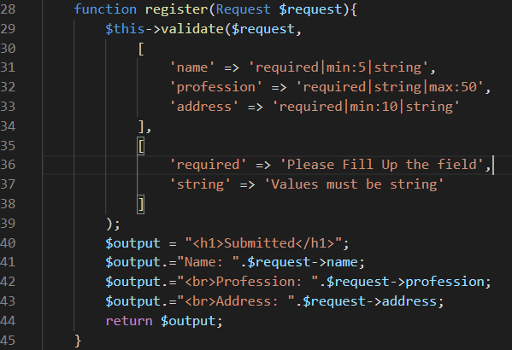
Customize Error Message
The validate function receives 3 parameters[Validator::make() also receives 3]
$this->validate($request,$rules,$messages)
Rules
Custom Error message

Slide 14
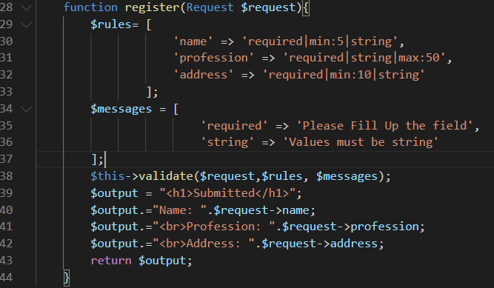
Customize Error Message
You can also define the rules and message in another array and pass the arrays.

Slide 15
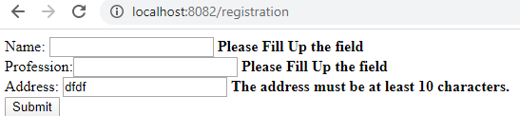
Customize Error Message
With previous techniques the modified error messages will work for all elements.
We can also customize messages for fields and errors also like below
For both name and profession required error occurred. Message is same.
[
'name.required' => 'Please Fill Up the name',
'name.min' => 'Minimum 5 Character',
'profession.required' => 'Please Fill Up the profession',
'address.min' => 'Please provide details address'
]

Slide 16
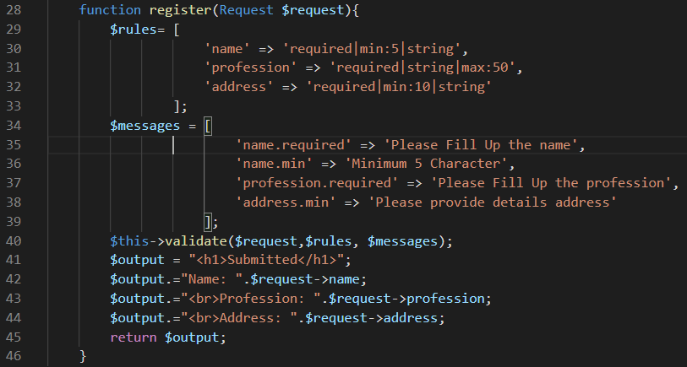
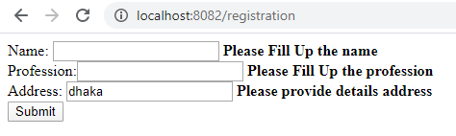
Customize Error Message
Output

Slide 17
Separating Validation: Request Class
We can create custom request class for validation. By using the following command we can create a request class:
php artisan make:request UserRequest
It will generate a class in this path App/Http/Requests/UserRequest.php
Inside this class we can set the validation rules in the rules function & custom message in the message function.

Slide 18
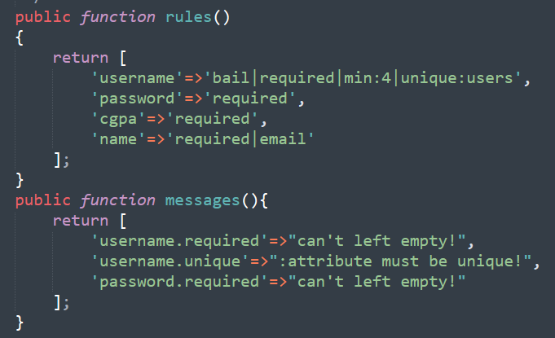
Request Class Example
We must have to make the return value true of authorize function. It will show an error message if we return false.

Slide 19
Books
PHP Advanced and Object-Oriented Programming, 3rd Edition; Larry Ullman; Peachpit, Press, 2013
PHP Objects, Patterns and Practice, 5th Edition; Matt Zandstra; Apress, 2016
Learning PHP, MySQL, JavaScript and CSS, 2nd Edition; Robin Nixon; O’Reilly, 2009
Eloquent JavaScript: A Modern Introduction to Programming; Marijn Haverbeke; 2011
Learning Node.js: A Hands On Guide to Building Web Applications in JavaScript; Marc Wandschneider; Addison-Wesley, 2013
Beginning Node.js; Basarat Ali Syed; Apress, 2014

Slide 20
References
https://laravel.com/docs/7.x/validation
https://laravel.com/docs/4.2/requests#old-input

Slide 21
Thank You!

